Slide 1
Introducing Methods
A method is a collection of statements that are grouped together to perform an operation.

Slide 2
cont.
Method signature is the combination of the method name and the parameter list.
The variables defined in the method header are known as formal parameters.
When a method is invoked, you pass a value to the parameter. This value is referred to as actual parameter or argument.

Slide 3
cont.
A method may return a value. The returnValueType is the data type of the value the method returns. If the method does not return a value, the returnValueType is the keyword void. For example, the returnValueType in the main method is void.

Slide 4
Calling Methods
Listing 5.1 Testing the max method
This program demonstrates calling a method max to return the largest of the int values
TestMax

Slide 5
cont.
animation

Slide 6
Trace Method Invocation
animation
i is now 5

Slide 7
Trace Method Invocation
animation
j is now 2

Slide 8
Trace Method Invocation
animation
invoke max(i, j)

Slide 9
Trace Method Invocation
animation
invoke max(i, j)
Pass the value of i to num1
Pass the value of j to num2

Slide 10
Trace Method Invocation
animation
declare variable result

Slide 11
Trace Method Invocation
animation
(num1 > num2) is true since num1 is 5 and num2 is 2

Slide 12
Trace Method Invocation
animation
result is now 5

Slide 13
Trace Method Invocation
animation
return result, which is 5

Slide 14
Trace Method Invocation
animation
return max(i, j) and assign the return value to k

Slide 15
Trace Method Invocation
animation
Execute the print statement

Slide 16
CAUTION
A return statement is required for a nonvoid method. The following method is logically correct, but it has a compilation error, because the Java compiler thinks it possible that this method does not return any value.
public static int sign(int n) {
if (n > 0) return 1;
else if (n == 0) return 0;
else if (n < 0) return –1;
}
To fix this problem, delete if (n<0) in the code.

Slide 17
Reuse Methods from Other Classes
NOTE: One of the benefits of methods is for reuse. The max method can be invoked from any class besides TestMax. If you create a new class Test, you can invoke the max method using ClassName.methodName (e.g., TestMax.max).

Slide 18
Call Stacks

Slide 19
Trace Call Stack
animation
i is declared and initialized

Slide 20
Trace Call Stack
animation
j is declared and initialized

Slide 21
Trace Call Stack
animation
Declare k

Slide 22
Trace Call Stack
animation
Invoke max(i, j)

Slide 23
Trace Call Stack
animation
pass the values of i and j to num1 and num2

Slide 24
Trace Call Stack
animation
pass the values of i and j to num1 and num2

Slide 25
Trace Call Stack
animation
(num1 > num2) is true

Slide 26
Trace Call Stack
animation
Assign num1 to result

Slide 27
Trace Call Stack
animation
Return result and assign it to k

Slide 28
Trace Call Stack
animation
Execute print statement

Slide 29
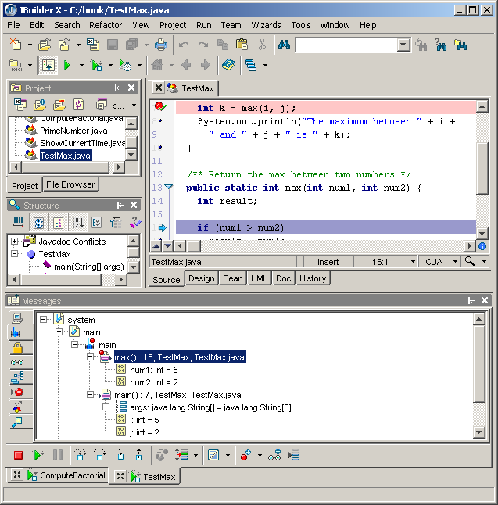
Call Stack in JBuilder Debugger
JBuilder Optional
You can see the chain of method invocations in the stack view of the JBuilder debugger.
Stack view
Invoke max
Invoke main

Slide 30
Passing Parameters
public static void nPrintln(String message, int n) {
for (int i = 0; i < n; i++)
System.out.println(message);
}
Suppose you invoke the method using
nPrintln(“Welcome to Java”, 5);
What is the output?
Suppose you invoke the method using
nPrintln(“Computer Science”, 15);
What is the output?
Notes:
public class MyClass { public static void main(String args[]) { // int x=10; // int y=25; // int z=x+y; // System.out.println("Sum of x+y = " + z); nPrintln("Welcome to Java", 5); } public static void nPrintln(String message, int n) { for (int i = 0; i < n; i++) System.out.println(message); }}

Slide 31
Overloading Methods
Listing 5.3 Overloading the max Method
public static double max(double num1, double num2) {
if (num1 > num2)
return num1;
else
return num2;
}
TestMethodOverloading

Slide 32
Ambiguous Invocation
Sometimes there may be two or more possible matches for an invocation of a method, but the compiler cannot determine the most specific match. This is referred to as ambiguous invocation. Ambiguous invocation is a compilation error.

Slide 33
Cont..
public class AmbiguousOverloading {
public static void main(String[] args) {
System.out.println(max(1, 2));
}
public static double max(int num1, double num2) {
if (num1 > num2)
return num1;
else
return num2;
}
public static double max(double num1, int num2) {
if (num1 > num2)
return num1;
else
return num2;
}
}

Slide 34
Case Study: Computing Taxes with Methods
Listing 3.1, “Computing Taxes,” uses if statements to check the filing status and computes the tax based on the filing status. Simplify Listing 3.1 using methods. Each filing status has six brackets.
The code for computing taxes is nearly same for each filing status except that each filing status has different bracket ranges. For example, the single filer status has six brackets [0, 6000], (6000, 27950], (27950, 67700], (67700, 141250], (141250, 307050], (307050, ∞), and the married file jointly status has six brackets [0, 12000], (12000, 46700], (46700, 112850], (112850, 171950], (171950, 307050], (307050, ∞).

Slide 35
cont.
The first bracket of each filing status is taxed at 10%, the second 15%, the third 27%, the fourth 30%, the fifth 35%, and the sixth 38.6%. So you can write a method with the brackets as arguments to compute the tax for the filing status. The signature of the method is:
For example, you can invoke computeTax(400000, 6000, 27950, 67700, 141250, 307050) to compute the tax for single filers with $400,000 of taxable income:
ComputeTaxWithMethod

Slide 36
Scope of Local Variables
A local variable: a variable defined inside a method.
Scope: the part of the program where the variable can be referenced.
The scope of a local variable starts from its declaration and continues to the end of the block that contains the variable. A local variable must be declared before it can be used.

Slide 37
cont.
You can declare a local variable with the same name multiple times in different non-nesting blocks in a method, but you cannot declare a local variable twice in nested blocks.

Slide 38
cont.
A variable declared in the initial action part of a for loop header has its scope in the entire loop. But a variable declared inside a for loop body has its scope limited in the loop body from its declaration and to the end of the block that contains the variable.

Slide 39
cont.

Slide 40
cont.
// Fine with no errors
public static void correctMethod() {
int x = 1;
int y = 1;
// i is declared
for (int i = 1; i < 10; i++) {
x += i;
}
// i is declared again
for (int i = 1; i < 10; i++) {
y += i;
}
}

Slide 41
cont.
// With no errors
public static void incorrectMethod() {
int x = 1;
int y = 1;
for (int i = 1; i < 10; i++) {
int x = 0;
x += i;
}
}

Slide 42
Method Abstraction
You can think of the method body as a black box that contains the detailed implementation for the method.
Notes:
পৃথক করা, নিষ্কাশিত করা। Abstract

Slide 43
A method without body (no implementation) is known as abstract method.
//abstract class
abstract class Sum{
/* These two are abstract methods, the child class
* must implement these methods
*/
public abstract int sumOfTwo(int n1, int n2);
public abstract int sumOfThree(int n1, int n2, int n3);
//Regular method
public void disp(){
System.out.println("Method of class Sum");
}
}
Notes:
https://beginnersbook.com/2014/01/abstract-method-with-examples-in-java/

Slide 44
Benefits of Methods
Write a method once and reuse it anywhere.
Information hiding. Hide the implementation from the user.
Reduce complexity.

Slide 45
The Math Class
Class constants:
PI
E
Class methods:
Trigonometric Methods
Exponent Methods
Rounding Methods
min, max, abs, and random Methods

Slide 46
Rounding Methods
double ceil(double x)
x rounded up to its nearest integer. This integer is returned as a double value.
double floor(double x)
x is rounded down to its nearest integer. This integer is returned as a double value.
double rint(double x)
x is rounded to its nearest integer. If x is equally close to two integers, the even one is returned as a double.
int round(float x)
Return (int)Math.floor(x+0.5).
long round(double x)
Return (long)Math.floor(x+0.5).

Slide 47
Rounding Methods Examples
Math.ceil(2.1) returns 3.0
Math.ceil(2.0) returns 2.0
Math.ceil(-2.0) returns –2.0
Math.ceil(-2.1) returns -2.0
Math.floor(2.1) returns 2.0
Math.floor(2.0) returns 2.0
Math.floor(-2.0) returns –2.0
Math.floor(-2.1) returns -3.0
Math.rint(2.1) returns 2.0
Math.rint(2.0) returns 2.0
Math.rint(-2.0) returns –2.0
Math.rint(-2.1) returns -2.0
Math.rint(2.5) returns 2.0
Math.rint(-2.5) returns -2.0
Math.round(2.6f) returns 3
Math.round(2.0) returns 2
Math.round(-2.0f) returns -2
Math.round(-2.6) returns -3

Slide 48
min, max, and abs
max(a, b)and min(a, b)
Returns the maximum or minimum of two parameters.
abs(a)
Returns the absolute value of the parameter.
random()
Returns a random double value in the range [0.0, 1.0).
Examples:
Math.max(2, 3) returns 3
Math.max(2.5, 3) returns 3.0
Math.min(2.5, 3.6) returns 2.5
Math.abs(-2) returns 2
Math.abs(-2.1) returns 2.1

Slide 49
The random Method
Generates a random double value greater than or equal to 0.0 and less than 1.0 (0 <= Math.random() < 1.0).
Examples:
In general,

Slide 50
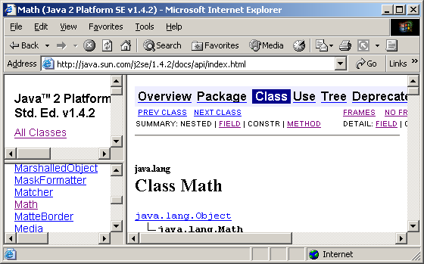
View java.lang.Math Documentation
JBuilder Optional
You can view the complete documentation for the Math class online from http://java.sun.com/j2se/1.5.2/docs/api/index.htm.

Slide 51
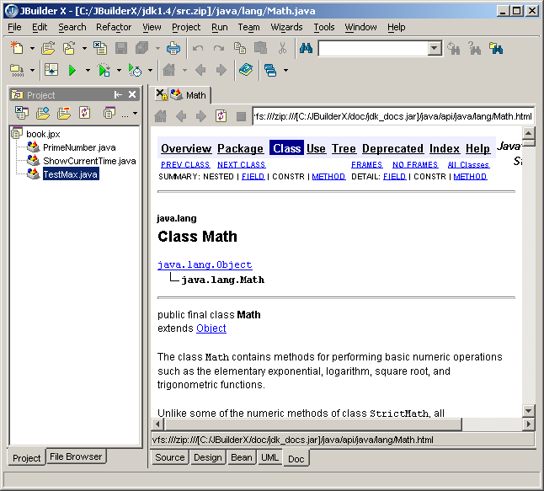
View java.lang.Math from JBuilder
JBuilder Optional
You can view the complete documentation for the Math class in JBuilder by choosing Search, Find Classes to display the Find Classes dialog box. Type java.lang.Math in the Class name field to display the documentation of the Math class in the content pane.

Slide 52
Package
Optional
There are three reasons for using packages:
To avoid naming conflicts. When you develop reusable classes to be shared by other programmers, naming conflicts often occur. To prevent this, put your classes into packages so that they can be referenced through package names.
To distribute software conveniently. Packages group related classes so that they can be easily distributed.
To protect classes. Packages provide protection so that the protected members of the classes are accessible to the classes in the same package, but not to the external classes.

Slide 53
Package-Naming Conventions
Packages are hierarchical, and you can have packages within packages. For example, java.lang.Math indicates that Math is a class in the package lang and that lang is a package in the package java. Levels of nesting can be used to ensure the uniqueness of package names.
Choosing a unique name is important because your package may be used on the Internet by other programs. Java designers recommend that you use your Internet domain name in reverse order as a package prefix. Since Internet domain names are unique, this prevents naming conflicts. Suppose you want to create a package named mypackage on a host machine with the Internet domain name prenhall.com. To follow the naming convention, you would name the entire package com.prenhall.mypackage. By convention, package names are all in lowercase.

Slide 54

Package Directories
Java expects one-to-one mapping of the package name and the file system directory structure. For the package named com.prenhall.mypackage, you must create a directory, as shown in the figure. In other words, a package is actually a directory that contains the bytecode of the classes.
com.prenhall.mypackage
The com directory does not have to be the root directory. In order for Java to know where your package is in the file system, you must modify the environment variable classpath so that it points to the directory in which your package resides.

Slide 55
Setting classpath Environment
Suppose the com directory is under c:\book. The following line adds c:\book into the classpath:
classpath=.;c:\book;
The period (.) indicating the current directory is always in classpath. The directory c:\book is in classpath so that you can use the package com.prenhall.mypackage in the program.

Slide 56
Putting Classes into Packages
Every class in Java belongs to a package. The class is added to the package when it is compiled. All the classes that you have used so far in this book were placed in the current directory (a default package) when the Java source programs were compiled. To put a class in a specific package, you need to add the following line as the first noncomment and nonblank statement in the program:
package packagename;

Slide 57
Listing 5.8 Putting Classes into Packages
Problem
This example creates a class named Format and places it in the package com.prenhall.mypackage. The Format class contains the format(number, numOfDecimalDigits) method that returns a new number with the specified number of digits after the decimal point. For example, format(10.3422345, 2) returns 10.34, and format(-0.343434, 3) returns –0.343.
Solution
1. Create Format.java as follows and save it into c:\book\com\prenhall\mypackage.
// Format.java: Format number.
package com.prenhall.mypackage;
public class Format {
public static double format(double number, int numOfDecimalDigits) {
return Math.round(number * Math.pow(10, numOfDecimalDigits)) /
Math.pow(10, numOfDecimalDigits);
}
}
2. Compile Format.java. Make sure Format.class is in c:\book\com\prenhall\mypackage.

Slide 58
Using Classes from Packages
There are two ways to use classes from a package.
One way is to use the fully qualified name of the class. For example, the fully qualified name for JOptionPane is javax.swing.JOptionPane. For Format in the preceding example, it is com.prenhall.mypackage.Format. This is convenient if the class is used a few times in the program.
The other way is to use the import statement. For example, to import all the classes in the javax.swing package, you can use
import javax.swing.*;
An import that uses a * is called an import on demand declaration. You can also import a specific class. For example, this statement imports javax.swing.JOptionPane:
import javax.swing.JOptionPane;
The information for the classes in an imported package is not read in at compile time or runtime unless the class is used in the program. The import statement simply tells the compiler where to locate the classes.

Slide 59
Listing 5.9 Using Packages
Problem
This example shows a program that uses the Format class in the com.prenhall.mypackage.mypackage package.
Solution
1. Create TestFormatClass.java as follows and save it into c:\book.
The following code gives the solution to the problem.
// TestFormatClass.java: Demonstrate using the Format class
import com.prenhall.mypackage.Format;
public class TestFormatClass {
/** Main method */
public static void main(String[] args) {
System.out.println(Format.format(10.3422345, 2));
System.out.println(Format.format(-0.343434, 3));
}
}

